Slide 1
Introduction to Tableau
Part 2
Notes:
Welcome back to Data Society! We have a great class ahead of us today.

Slide 2
Module completion checklist
Objective | Complete
Explore the Tableau platform layout
Create basic visuals using the World Data

Slide 3
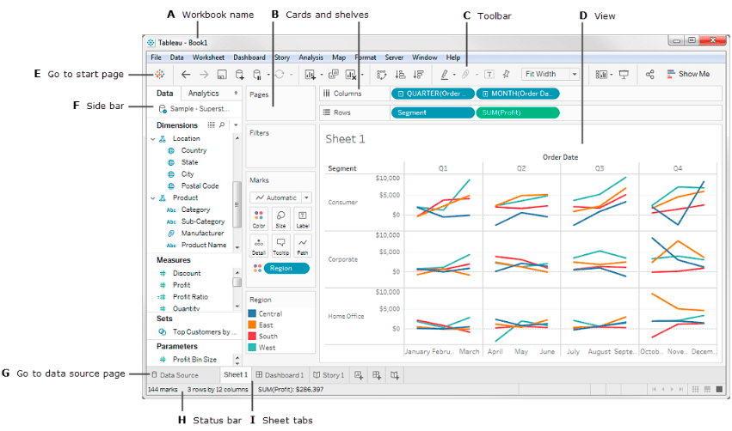
Overview: key parts of Tableau UI
Start button
Data and analytics views
Sheets view
Marks panel
Story tab
Dashboard tab
Columns and row shelves
Variable “pills”
“Show Me” panel
Notes:
The purpose of this slide is to provide an overview of different parts of the Tableau user interface (UI). POINT OUT and EXPLAIN each of the features from A through I. HIGHLIGHT the other elements in the list at left, ending with Data and analytics views and “Show Me” palette, covered in more detail on the coming slides.

Slide 4
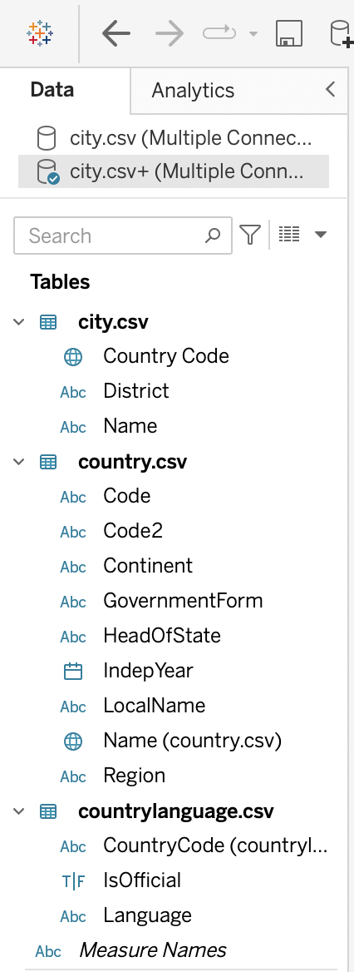
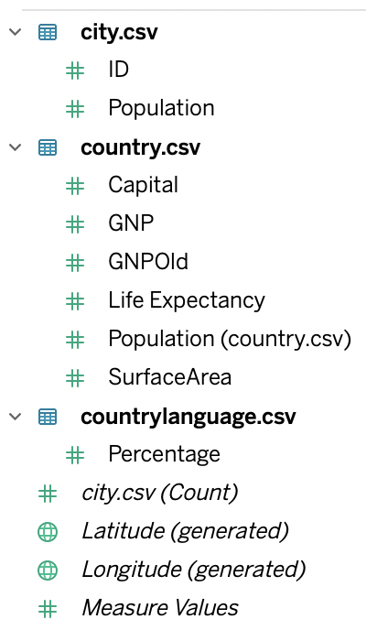
Data tab
The data tab shows several key pieces of information:
Dimensions and Measures variables
Loaded databases
Sets
Parameters
Note that the type of variable is noted to the left of the variable name in the form of an icon.
Notes:
The purpose of this slide is to introduce the data tab and the kinds of information it contains.

Slide 5
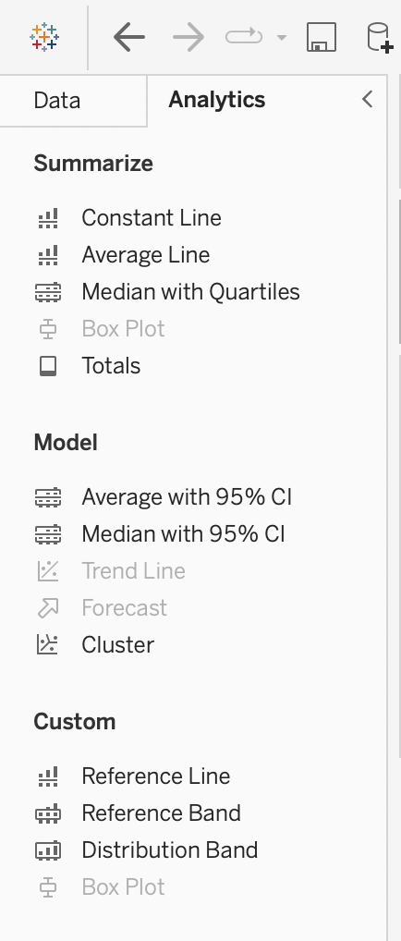
Analytics tab
The analytics tab is divided into 3 groups based on functionality:
Summarize
Model
Custom
It is used to apply advanced analytics to the view and provides drag-and-drop functionality for various options.
You can add box plots, reference lines, and other elements to your view.
Notes:
The purpose of this slide is to introduce the analytics tab and the kinds of information it contains.

Slide 6
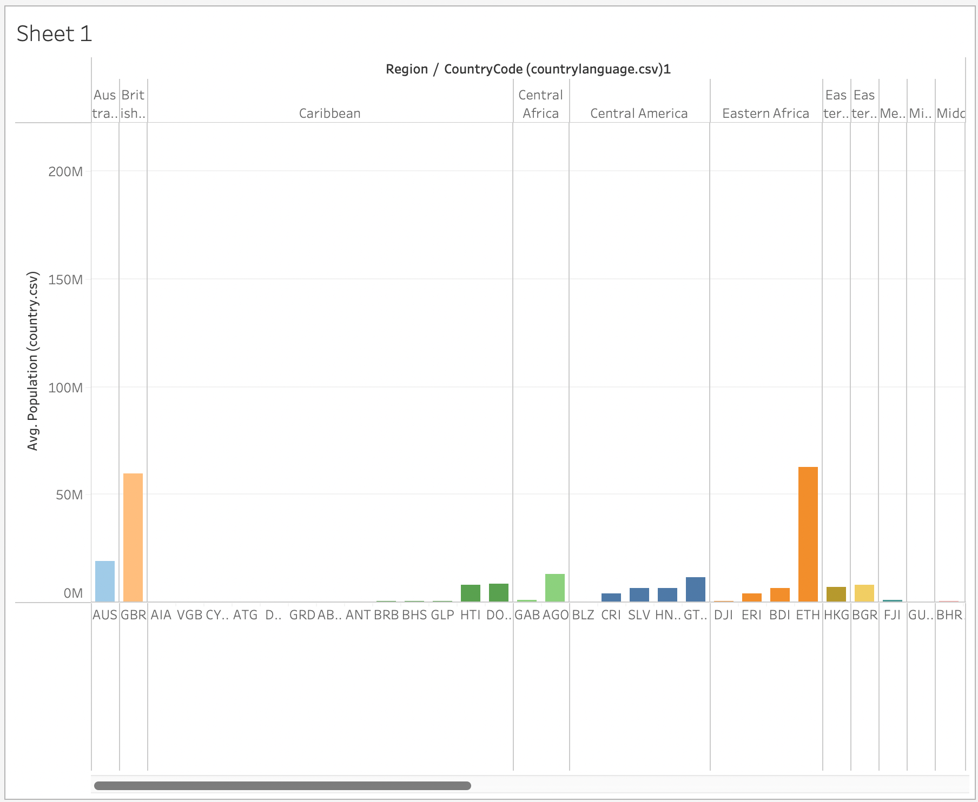
Workbooks vs. sheets view
In Tableau, workbook and sheet file structures are used.
A workbook contains a single view along with legends, cards, shelves, and a data and analytics tab in its sidebar.
A sheet can be a story, workbook, or dashboard.

Slide 7
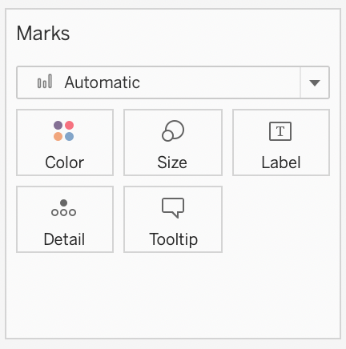
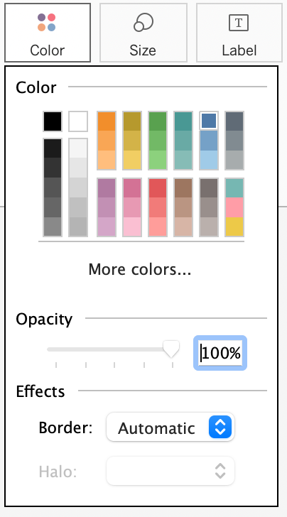
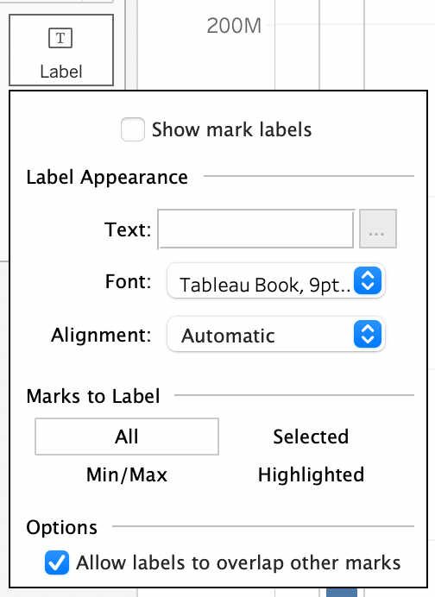
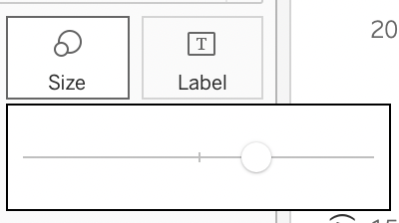
Marks panel
To display data, Tableau uses marks where every mark corresponds to a single data point in the dataset.
The default mark type depends on the values in the rows and columns shelves, but different types of marks can be selected using the marks panel.
The Marks panel allows you to encode data with color, size, shape, text and details.
Notes:
The purpose of this slide is to introduce the marks panel and the features it provides.

Slide 8
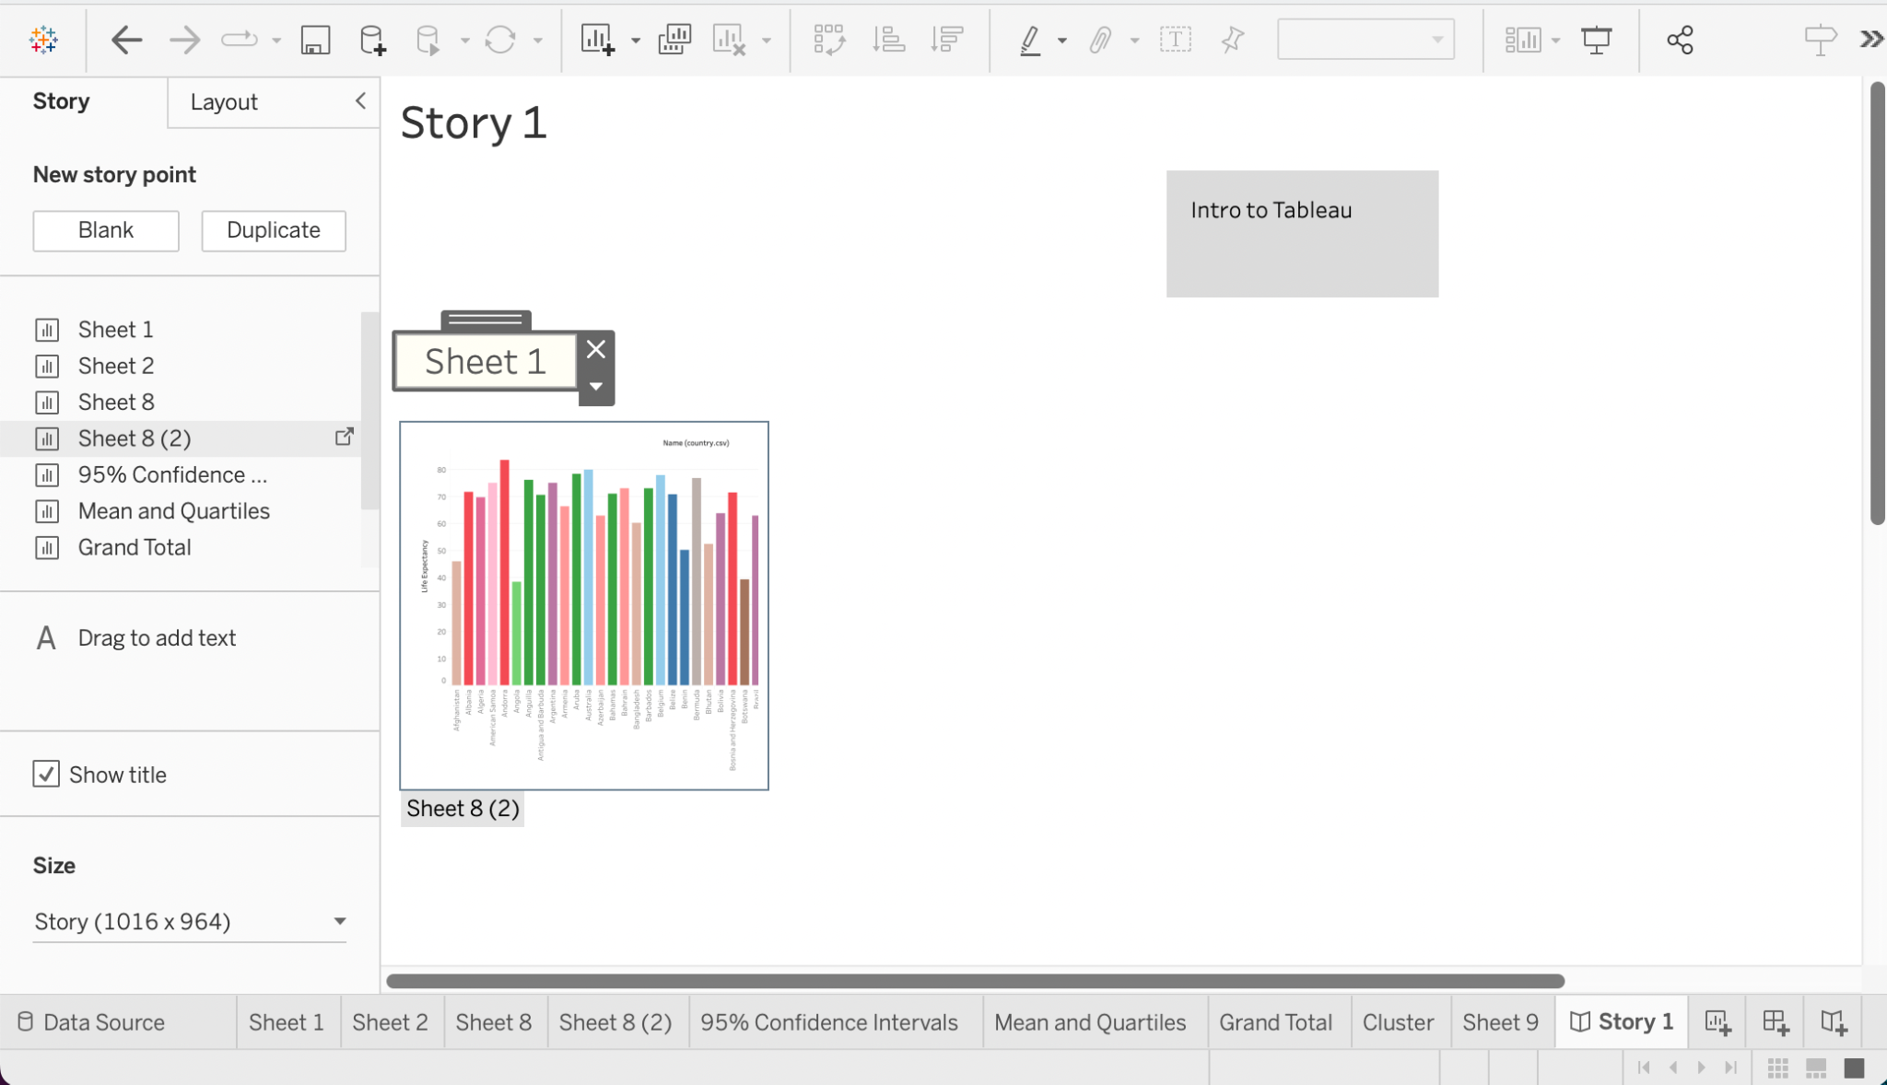
Story tab
Tableau allows you to create stories by arranging a series of visualizations that work together to present information.
You can add a title, text, and customize the size of a story using the story tab.
The Story tab also lets you drag-and-drop the visualisation on a story sheet.
Notes:
The purpose of this slide is to introduce the story tab, information it contains and the features it provides.

Slide 9
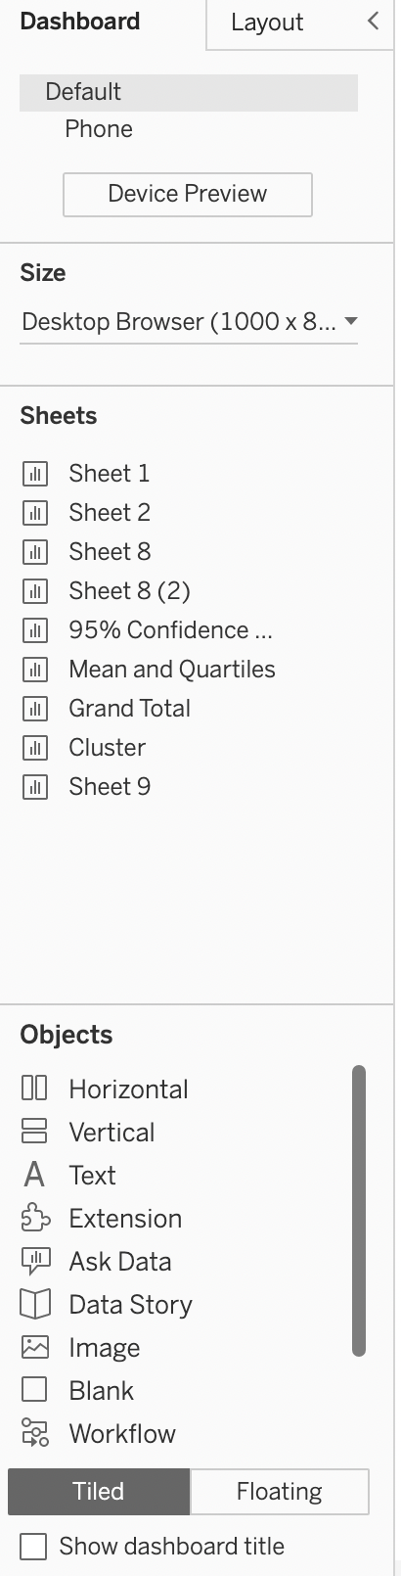
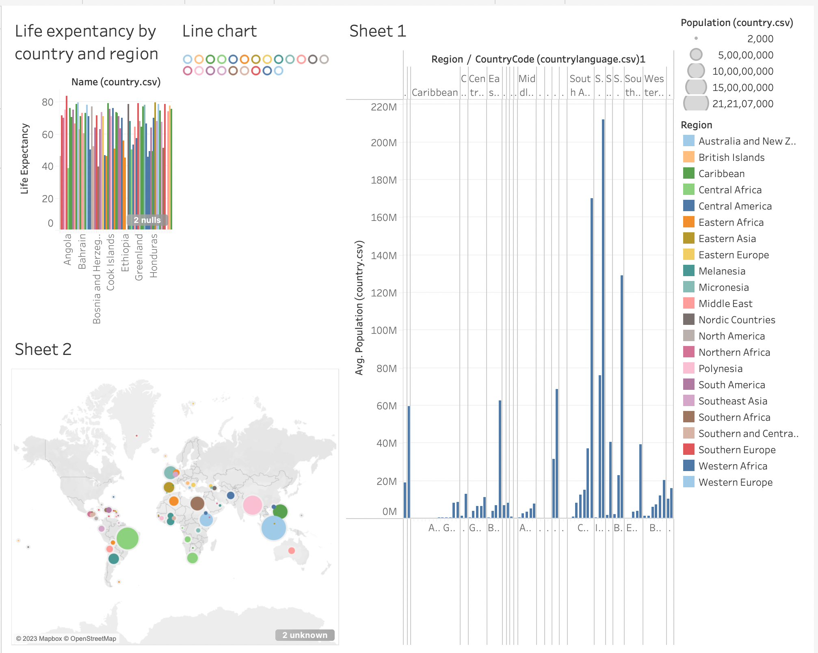
Dashboard tab
The dashboard tab contains the list of all available sheets, and allow us to add multiple sheets on a dashboard.
It contains variety of objects such as text, web page, button, extensions, etc.
These objects makes dashboards more interactive and dynamic.
Notes:
The purpose of this slide is to introduce the data tab, information it contains and the features it provides.

Slide 10
Column and row shelves
Use the column shelf to create the columns in a table.
Use the row shelf to create rows in a table.
Any number of fields can be placed on these shelves.
Notes:
The purpose of this slide is to introduce the columns and row shelves and the information it contains

Slide 11
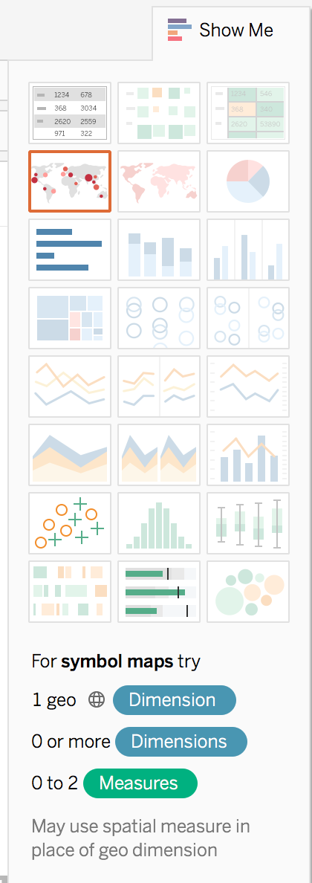
“Show Me” palette
The “Show Me” palette makes it easy to choose the visualization that you want.
Tableau automatically adjusts dimensions and measures to better fit your data to the map.
It also suggests which visualizations might best suit the data you are working with.
Notes:
The purpose of this slide is to introduce the “Show Me” pallette and explain how Tableau recommends visualizations.

Slide 12
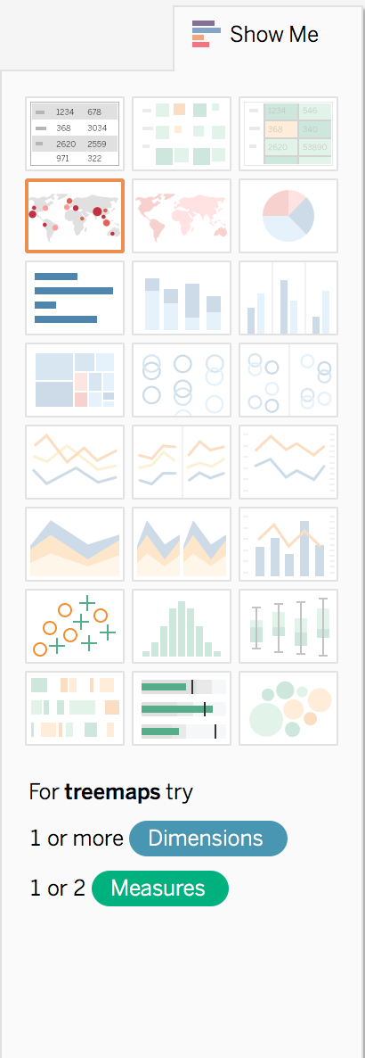
Grayed-out “Show Me” options
Grayed-out visualizations cannot be generated from the given data.
When selecting a grayed-out visualization type, pay attention to the suggestions on the bottom.
Notes:
The purpose of this slide is to explain why some visualization options appear grayed-out in the “Show Me” palette.

Slide 13
Module completion checklist
Objective | Complete
Explore the Tableau platform layout
Create basic visuals using the World Data

Slide 14
Save your work!
We will now start creating visualizations in Tableau.
We will see a lot of different insights from the data as we learn more about Tableau.
Make sure to save all your classwork (including exercises) on your local drive!
Over the coming classes, we will put these visualizations together into a story.
Notes:
The purpose of this slide is to remind students to continually save their work over the duration of the Tableau unit. Each visualization will eventually become part of a story, so it’s important for each student to keep track of their successive final products.

Slide 15
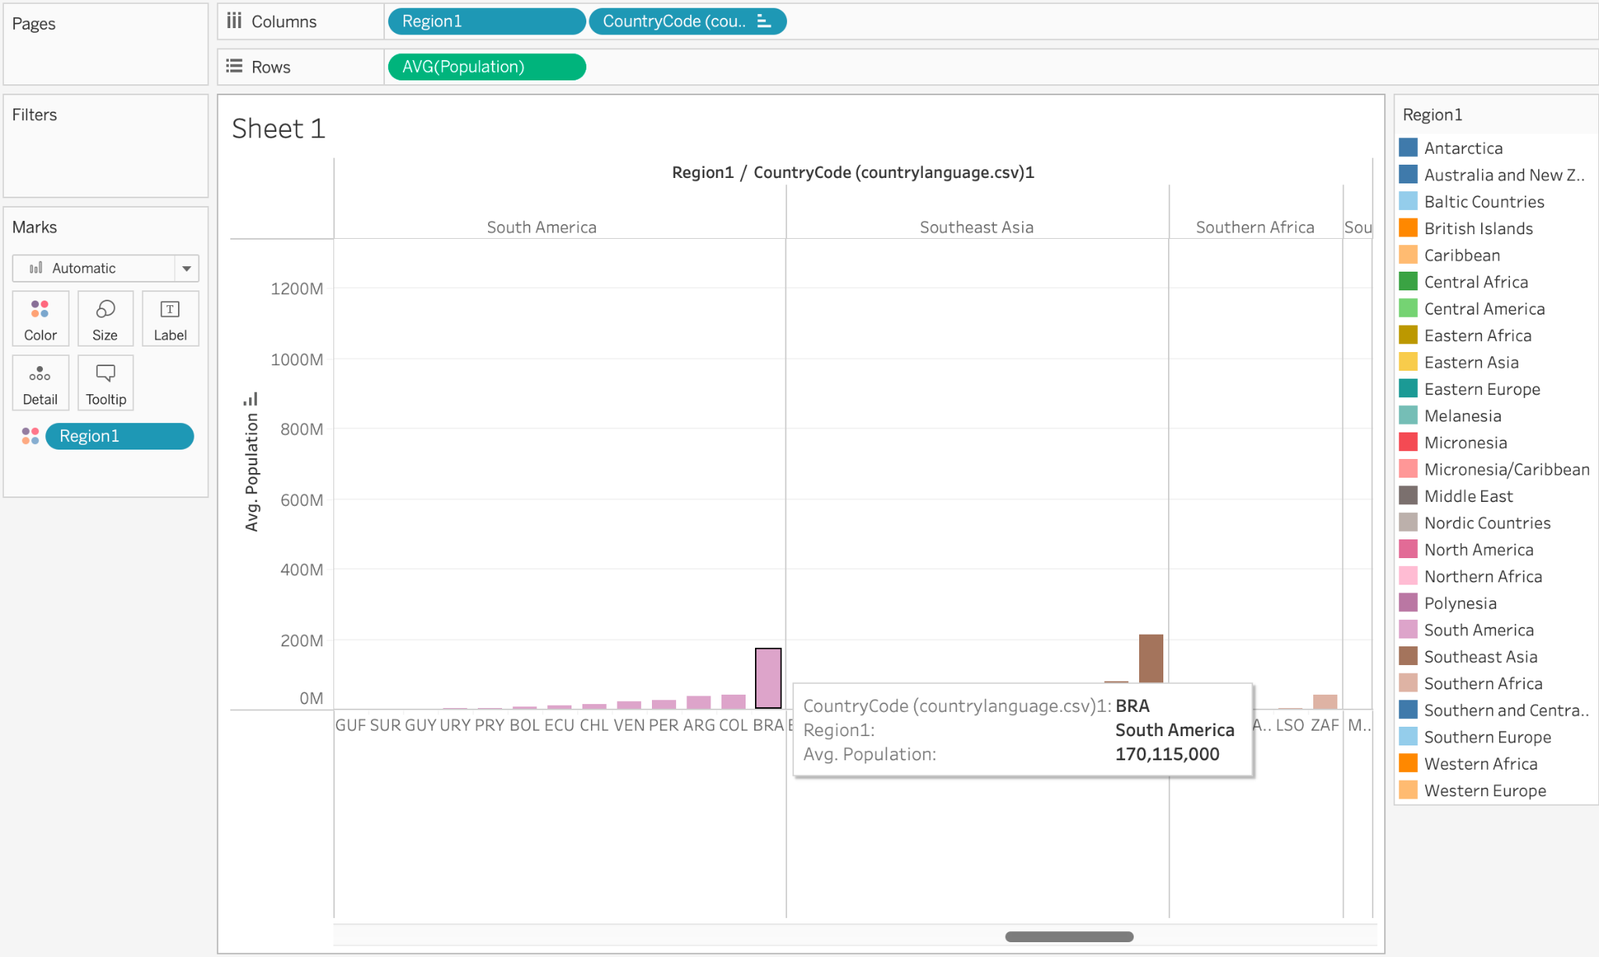
Data visualization: bar charts
Let’s plot average population by country and categorize the bar chart by region.
Notes:
The purpose of this slide is to introduce the first visualization students will be making in Tableau, a bar chart. WALK THROUGH how to generate the image above.

Slide 16
Evaluating our bar chart
What do you see from the graph?
Is there anything that you would change?
What follow-on visualizations might you make? Why?
Notes:
The purpose of this slide is to encourage evaluation and further exploration of the dataset based on the bar chart. ASK students the three questions on the slide and COMMENT on their responses.

Slide 17
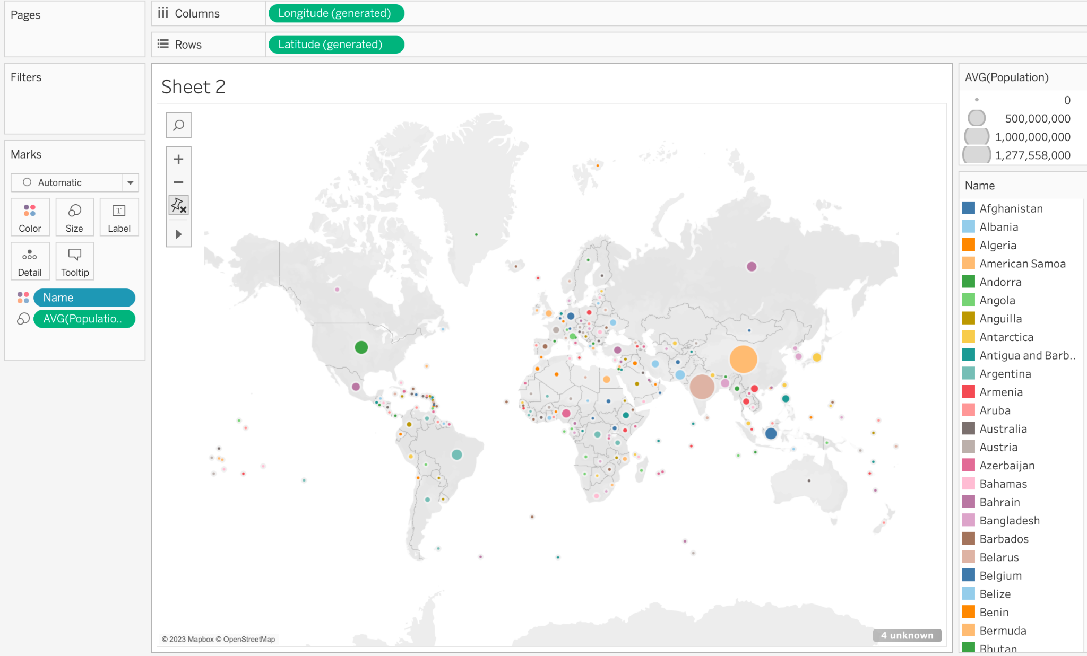
Data visualization: symbol map
We will now plot the same information on a map.
Notes:
The purpose of this slide is to invite students to produce their next visualization, a symbol map. WALK THROUGH how to generate the image above.

Slide 18
Evaluating our symbol map
Is this view of the data better? Worse?
Is there anything that is missing from the data?
How might you make the map more usable?
Notes:
The purpose of this slide is to encourage evaluation and further exploration of the dataset based on the bar chart. ASK students the three questions on the slide and COMMENT on their responses.

Slide 19
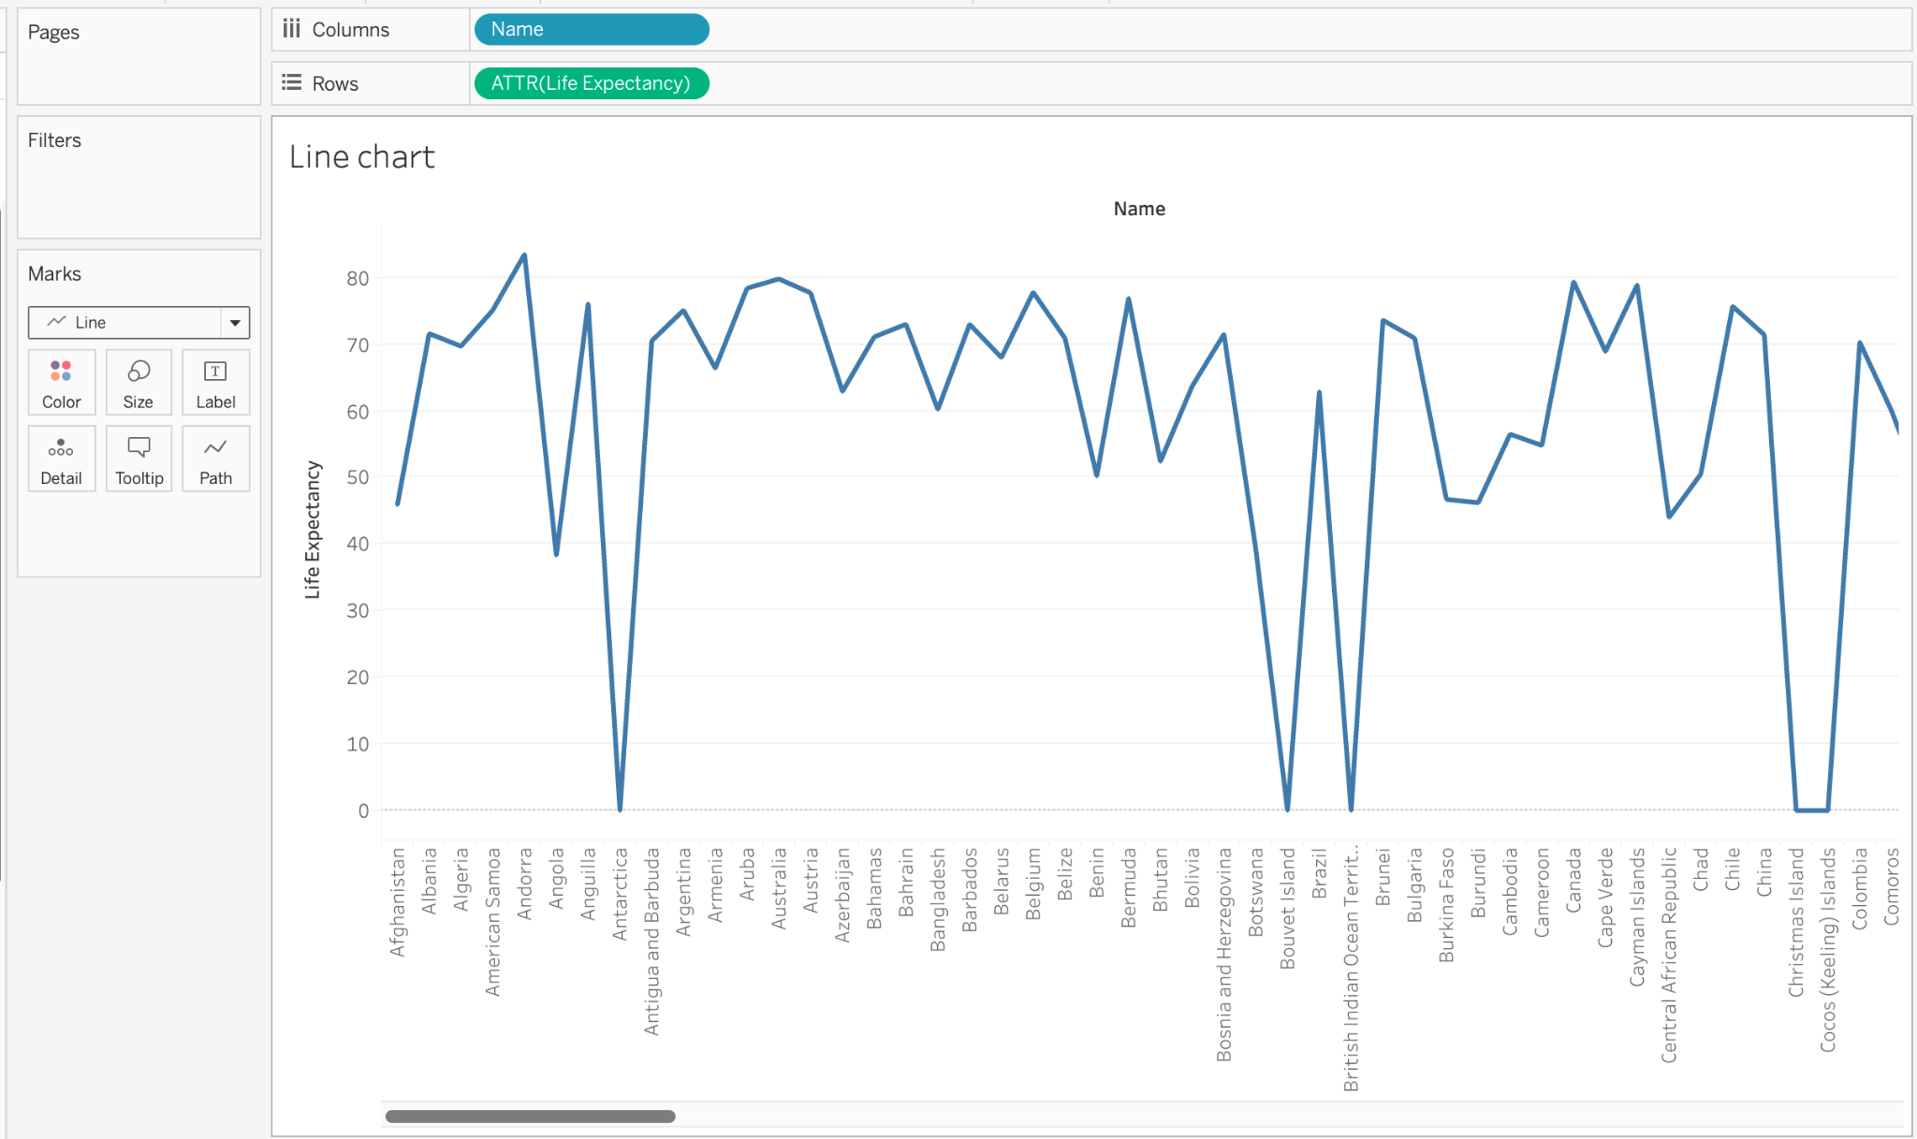
Data visualization: line chart
We will now make a third graph, life expectancy by country.
Notes:
The purpose of this slide is to invite students to produce their next visualization, a line chart. WALK THROUGH how to generate the image above.

Slide 20
Data visualization: line chart
What do you see from the graph?
Is there anything that you would change?
What follow-on visualizations might you make? Why?
Notes:
The purpose of this slide is to encourage evaluation and further exploration of the dataset based on the line chart. ASK students the three questions on the slide and COMMENT on their responses.

Slide 21
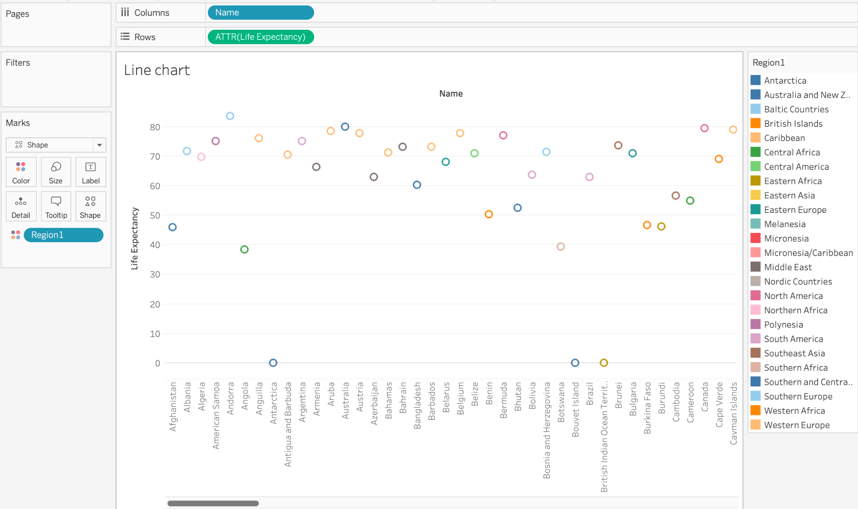
Data visualization: shape plot
Let’s use points to visualize the regions that contributed to the graph.
Notes:
The purpose of this slide is to invite students to produce their next visualization, a shape plot. WALK THROUGH how to generate the image above.

Slide 22
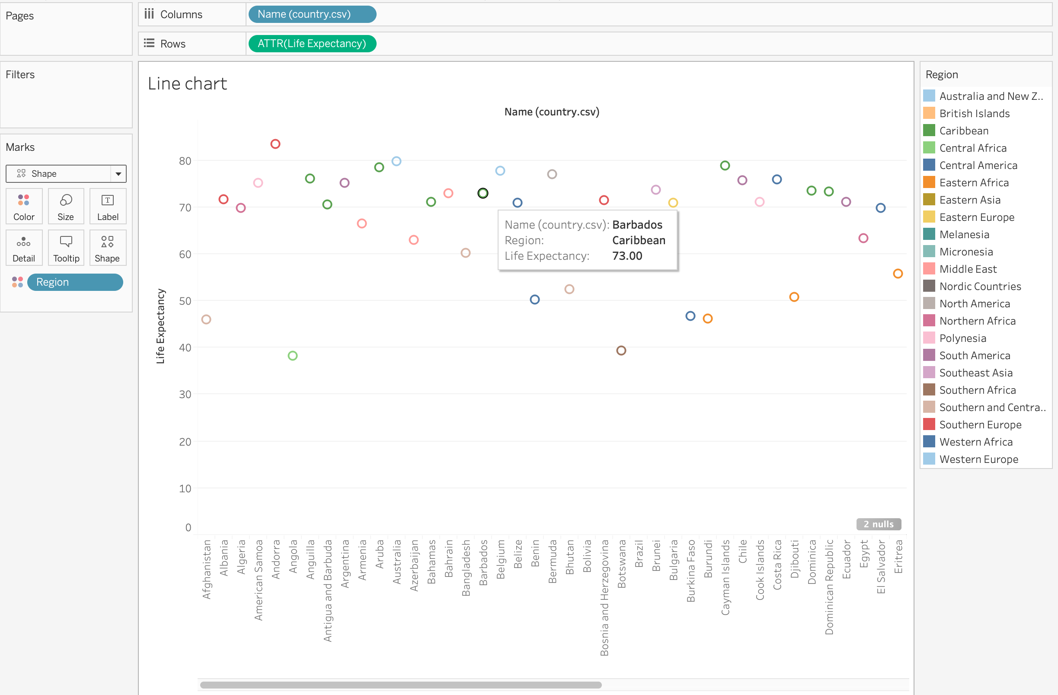
Color shape plot by region
Annotation by region allows us to drill down.
We can see regional clustering of countries and their life expectancy.
Notes:
The purpose of this slide is to describe how annotations function within Tableau. Grouping the data by region generates regional clustering of countries and life expectancy.

Slide 23
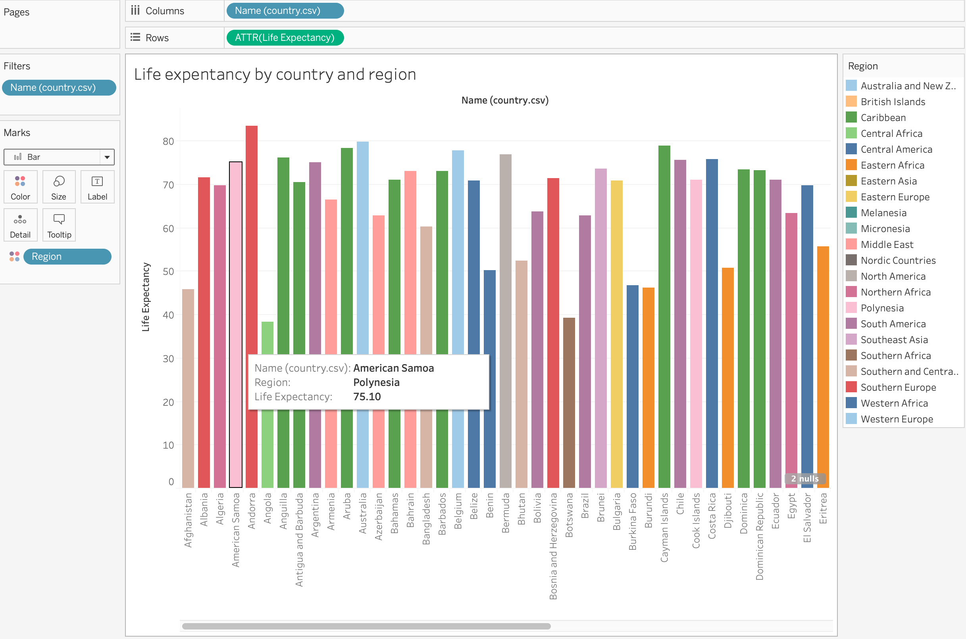
Data visualization: bar chart, revisted
We previously used bar charts to plot the average population.
Let’s revisit bar charts to plot the life expectancy information categorized by region.
As we can see, there are many different ways to plot the same information.
The trick is to find the visual that best suits the use case.
Notes:
The purpose of this slide is to show the transformation of the same data (life expectancy by country and region) from a line chart to a bar chart. EXPLAIN that while Tableau allows for quick and easy visualization of data, the art and skill lies in settling on the visualization that best represents the information you’re working with.

Slide 24
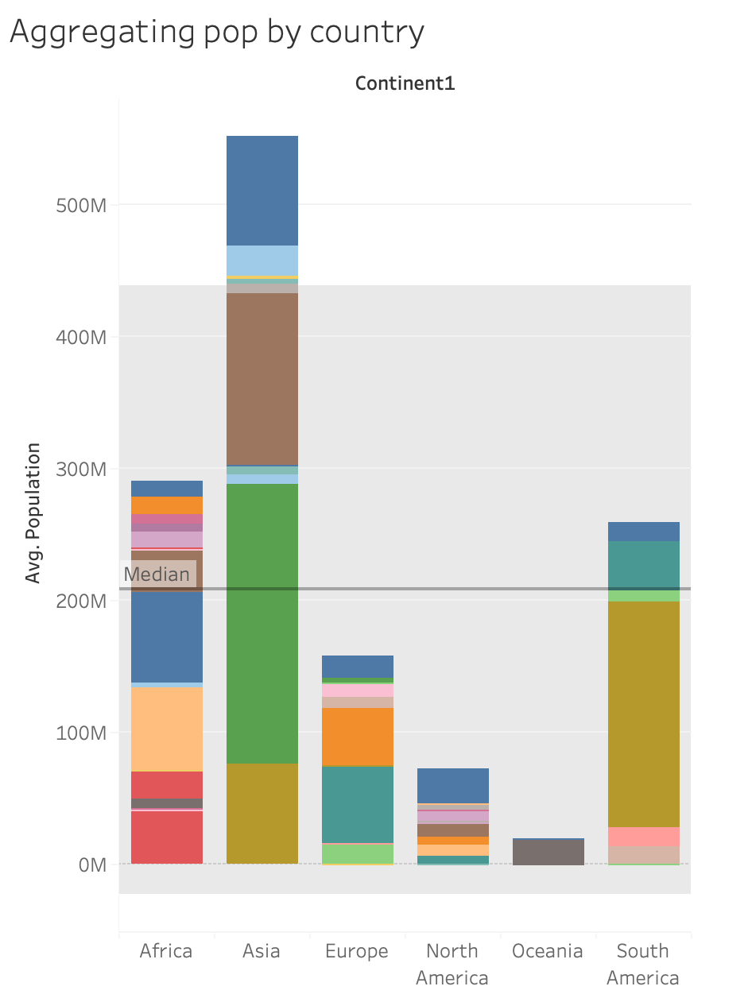
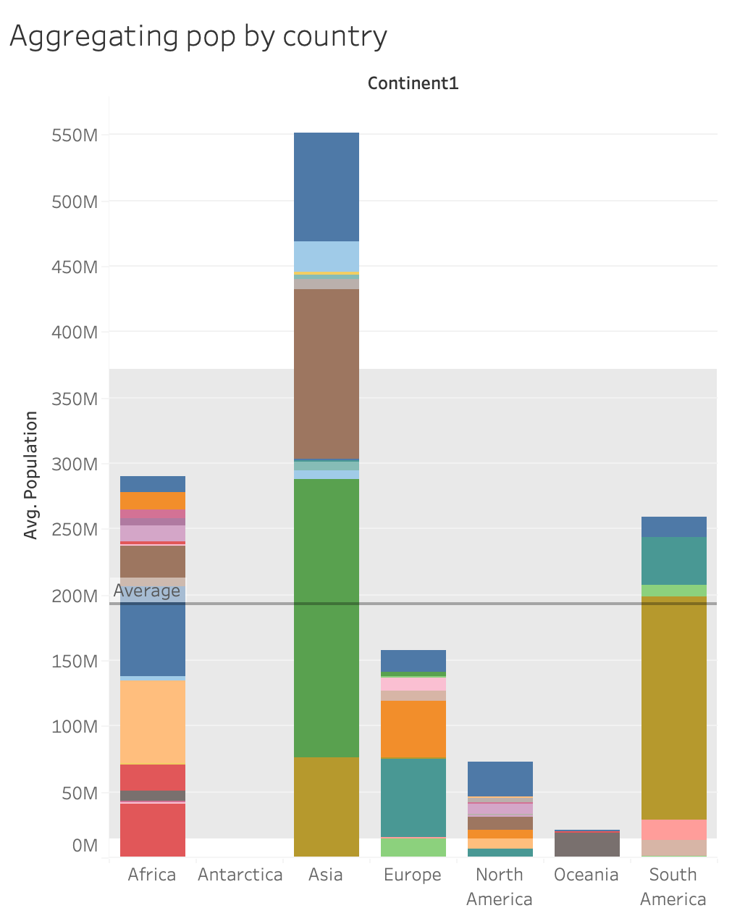
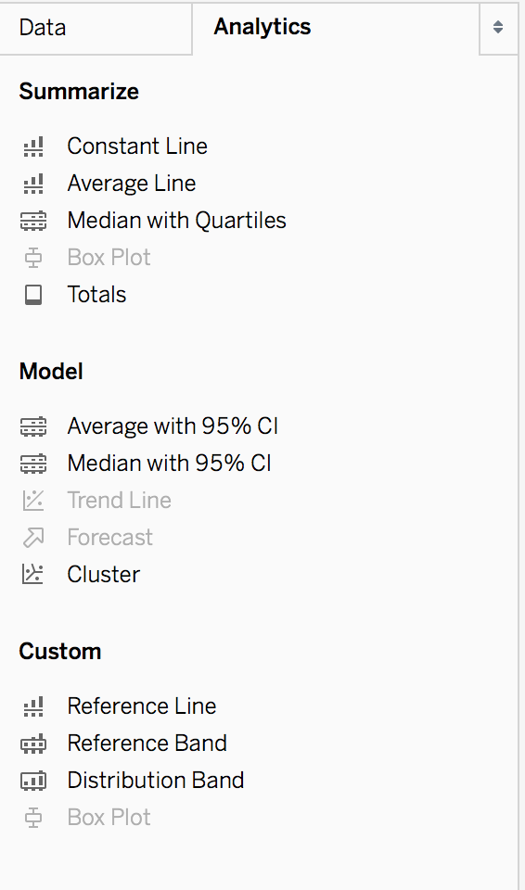
Annotating with the Analytics tab
From the Analytics tab, you can annotate features like central tendency and distribution.
Mean line with 95% confidence interval
Median with quartiles with 95% CI
You can even manually add lines.
Notes:
The purpose of this slide is to introduce annotations in the Analytics tab. WALK THROUGH how to create the images above, after reminding students of the location of the Analytics tab (alongside the Data tab).

Slide 25
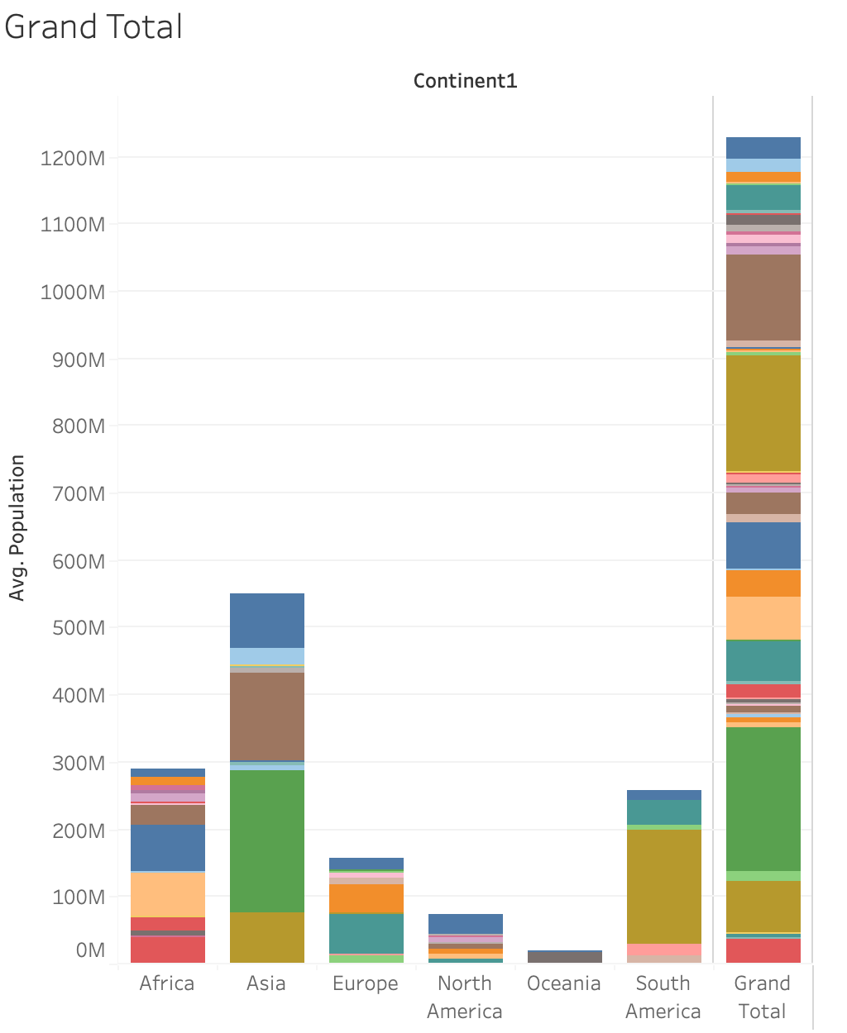
Totals in the Analytics tab
We can also get a grand total column appended to the end of our visualization.
Can anyone spot a red flag to look out for after the totals are graphed?
Notes:
The purpose of this slide is to introduce the Total function in the Analytics tab. WALK THROUGH how to create the image above. ASK what problem presents itself after graphic the grand total and COMMENT on responses.
POINT OUT that the problem is that it drastically changes the scale of the y-axis

Slide 26
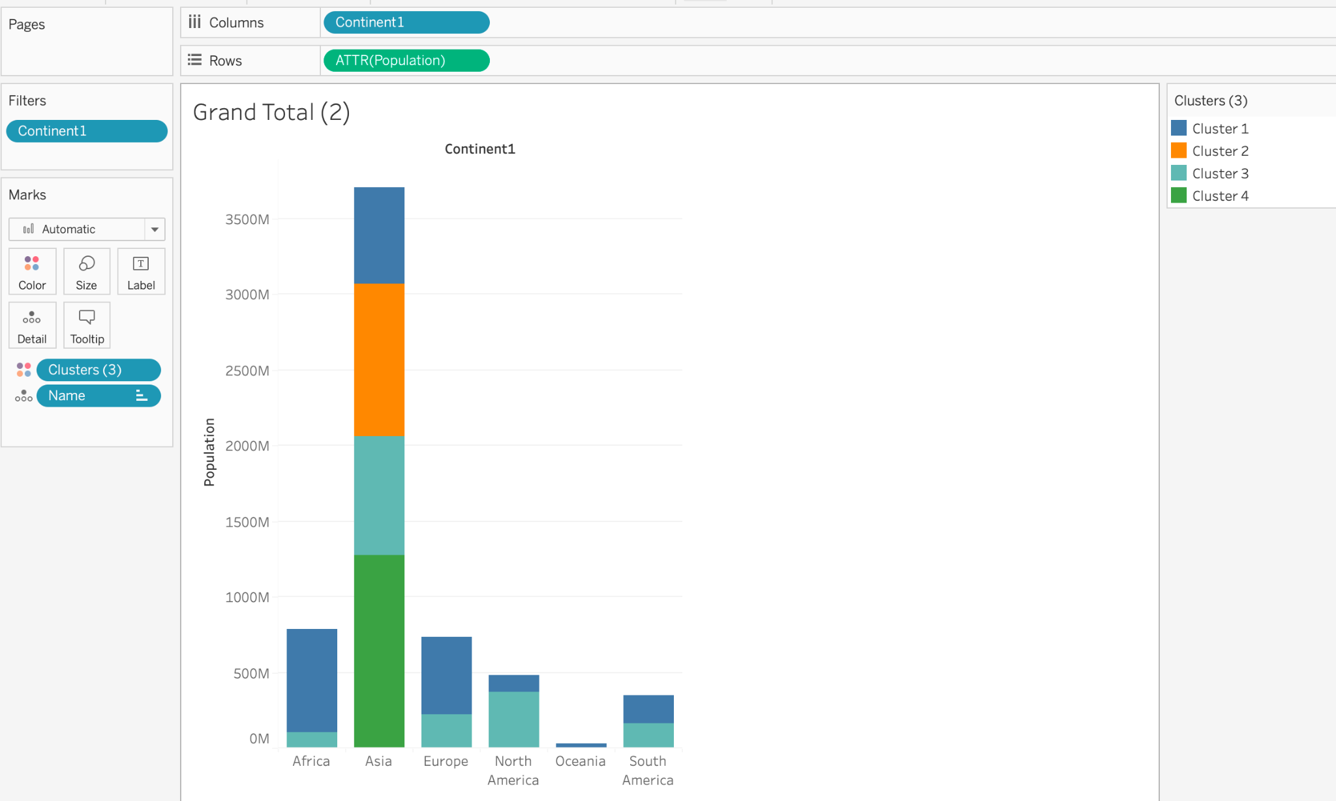
Clustering in the Analytics tab
We can use clustering to automatically cluster by any attribute.
Here we automatically clustered by attribute: population size.
Cluster the data on your analysis.
Notes:
The purpose of this slide is to introduce the Cluster function in the Analytics tab. WALK THROUGH how to create the image above. ASK students to make some basic observations about the clusters that emerged and COMMENT on their observations.

Slide 27
Summing up the world data
Let’s go through our critical insights from this analysis.
Bar chart of populations
Map of populations
Line chart - life expectancy
What are some next steps in this analysis?
What analysis would you do next?
What data would you like to have that you do not have?
Notes:
The purpose of this slide is to summarize some of the insights generated by manipulating data visualizations in Tableau.
The slide also affords an opportunity to ASK students the three questions listed above, and to COMMENT on their responses. Feel free to SUGGEST what interests you most about the data and where you might go next.

Slide 28
Data integrity
Data integrity refers to the completeness, representativeness, and cleanliness of a given dataset.
Can you identify any likely gaps, anomalies, or untidiness in the data?
How would you deal with these?
What did you check?
Is there anything that you should check but did not have time to?
Notes:
The purpose of this slide is to focus students’ attention on potential issues of data integrity with the world dataset. ASK the questions listed out on the slide and COMMENT on students’ responses. EMPHASIZE that as you perform successive visualizations, it’s always important to come back to the original dataset and ask about gaps, anomalies, and tendencies that may reflect issues best remedied through data cleaning, imputation, and further collection.

Slide 29
Knowledge check 2

Slide 30
Exercise 2

Slide 31
Module completion checklist
Objective | Complete
Explore the Tableau platform layout
Create basic visuals using the World Data

Slide 32
Congratulations!
In the past few modules, we covered:
Importing data
CSV
SQL server
Tableau parts
Data integrity
Dimensions and Measures
“Show Me” palette
Charts and Figures
bar chart
symbol map
shape plot
line plot
Analytics tab
annotations
clusters
total
Notes:
The purpose of this slide is to review the various topics covered in class today. It is also an opportunity to ASK if students have any outstanding questions that need to be resolved.

Slide 33
Next steps
In the next few modules, we will cover:
Grouping and Aggregation in Tableau
Filtering options
Notes:
The purpose of this slide is to introduce the agenda for the next session. COMMENT briefly on each topic to set expectations and encourage prediction.

Slide 34
End of Part 2
‹#›

